Slide 1
CSS
Box model & positioning

Slide 2
<SPAN> & <DIV>
They are used to group together a chunk of HTML and hook some information onto that chunk
The difference between span and div is that a span element is in-line and usually used for a small chunk of HTML inside a line (such as inside a paragraph) whereas a div (division) element is block-line (which is basically equivalent to having a line-break before and after it) and used to group larger chunks of code.

Slide 3
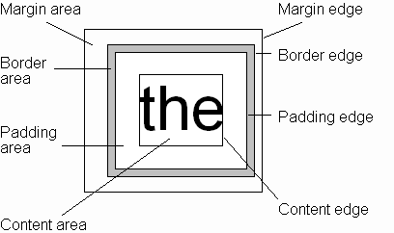
CSS Box Model
Every rendered element occupies a box:
Every rendered element occupies a box:
(or outer edge)
(or inner edge)

Slide 4
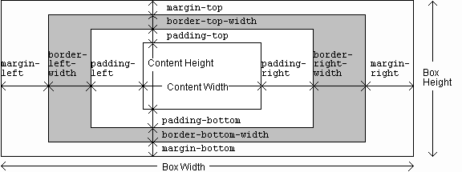
CSS Box Model

Slide 5

CSS POSITIOniNG

